Slide 1
5.2 Least Squares Linear Regression

Slide 2
In this Section we formally describe the problem of linear regression, or the fitting of a representative line (or hyperplane in higher dimensions) to a set of input/output data points.

Slide 3
Regression in general may be performed for a variety of reasons, in order to:
produce a so-called trend line (or - more generally - a curve) that can be used to help visually summarize
drive home a particular point about the data under study,
or to learn a model so that precise predictions can be made regarding output values in the future.

Slide 4
Notation and modeling

Slide 5
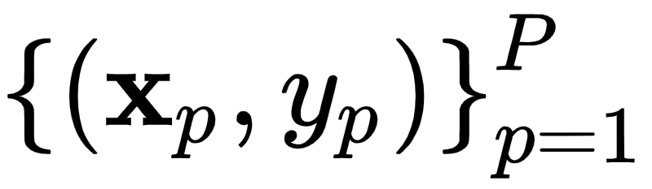
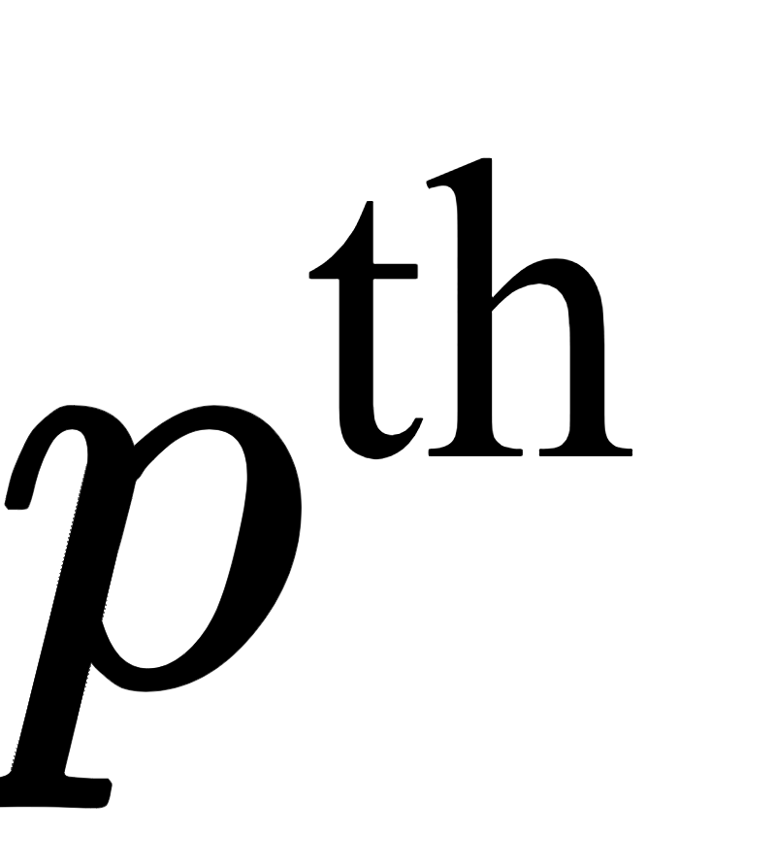
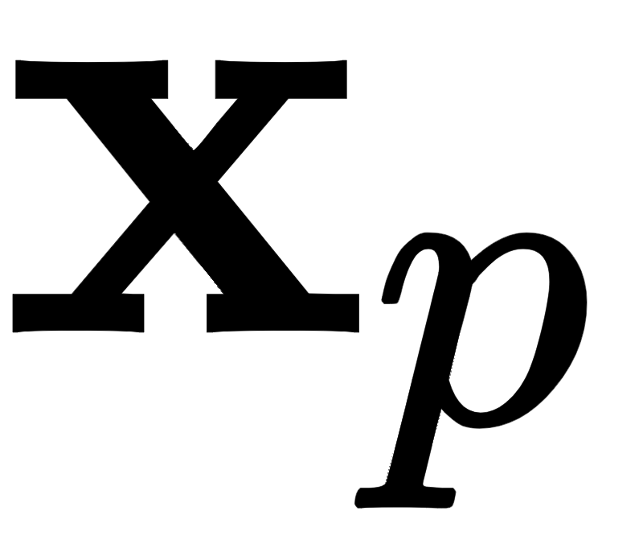
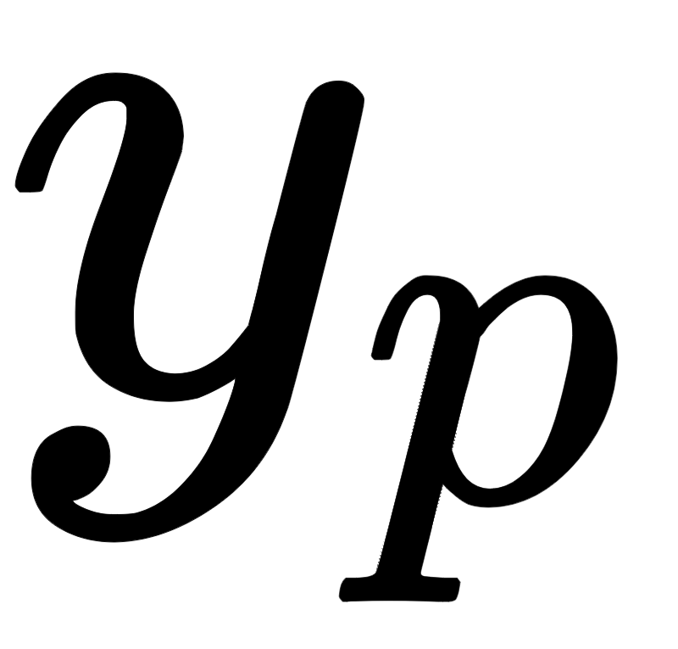
Data for regression problems comes in the form of a set of $P$ input/output observation pairs
More compactly this is , where and denote the input and output respectively.
In simple instances the input is scalar-valued (the output will always be considered scalar-valued here), and hence the linear regression problem is geometrically speaking one of fitting a line to the associated scatter of data points in 2-dimensional space.

Slide 6
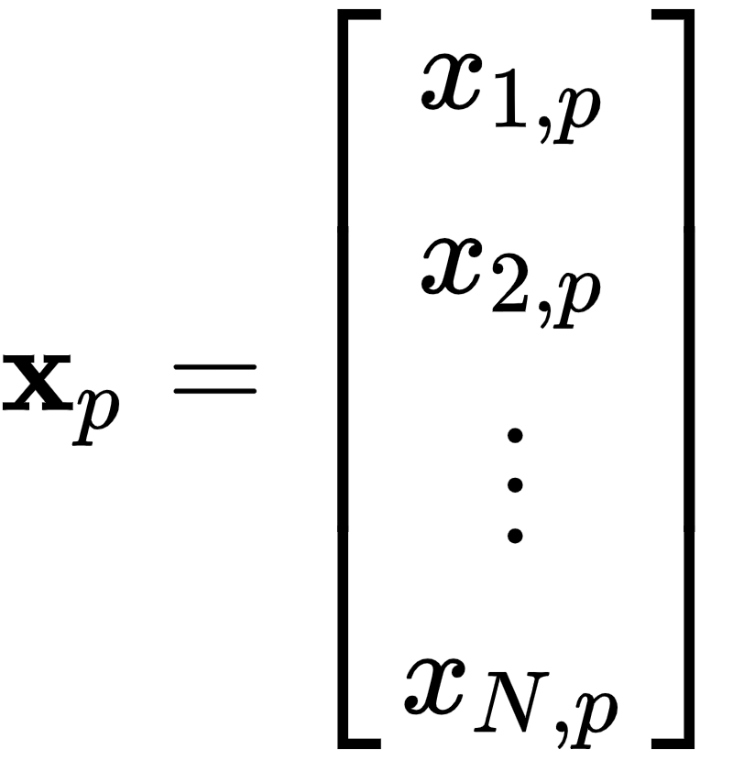
- In general however each input may be a column vector of length N
In this case the linear regression problem is analogously one of fitting a hyperplane to a scatter of points in N+1 dimensional space.

Slide 7
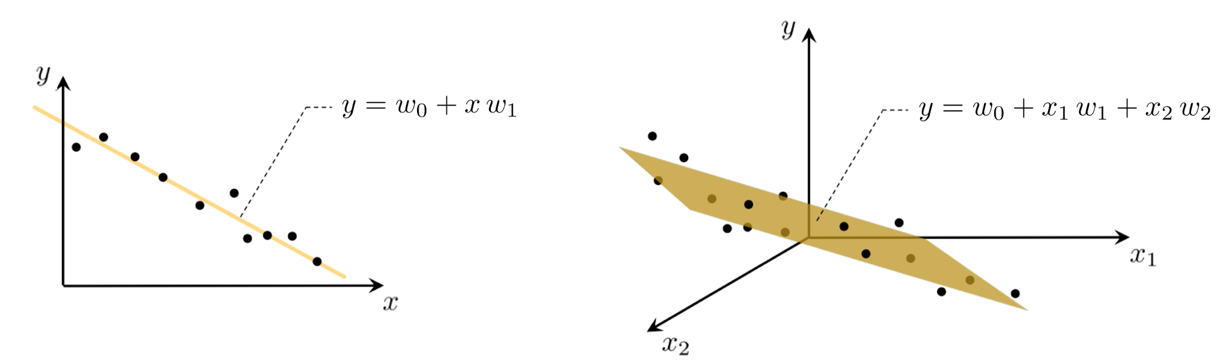

Slide 8
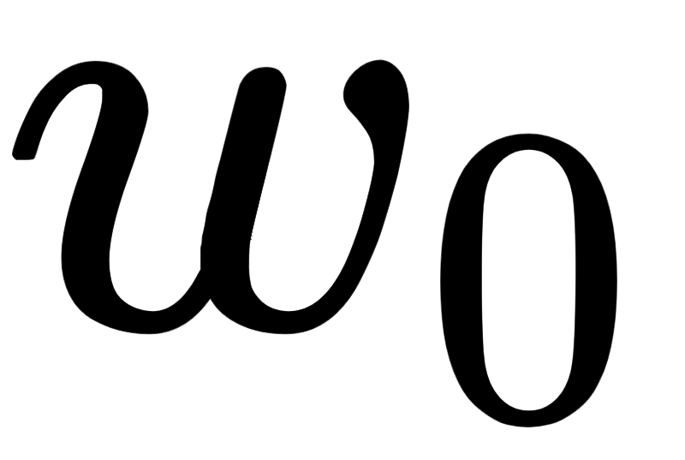
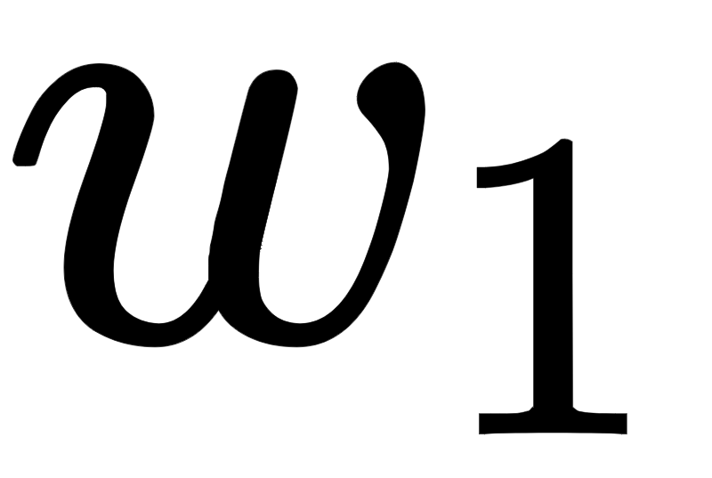
With scalar input we must determine appropriate vertical intercept and slope so that the following holds
Notice that we have used the approximately equal sign because we cannot be sure that all data lies completely on a single line.
More generally, when dealing with N dimensional input we have a bias and N associated slope weights to tune properly

Slide 9

Note: each dimension of the input is referred to in the jargon of machine learning as a feature or input feature.
So we will often refer to as the feature-touching weights (the only weight not touching a feature is the bias ).

Slide 10


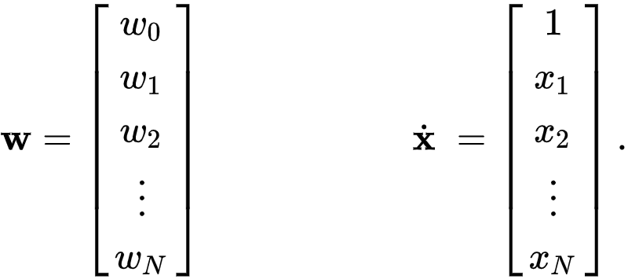
For any N we can write the above more compactly - in particular using the notation to denote an input with a 1 placed on top of it as

Slide 11
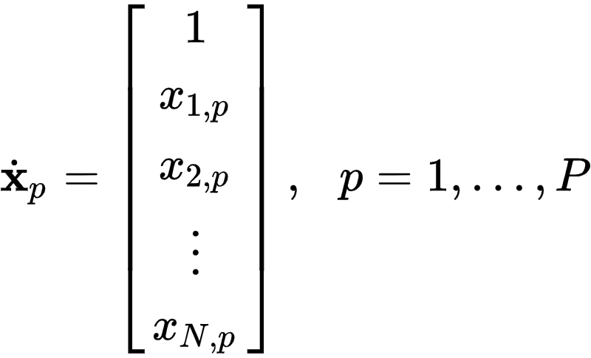
In particular, this means that we stack a 1 on top of each of our input points as

Slide 12
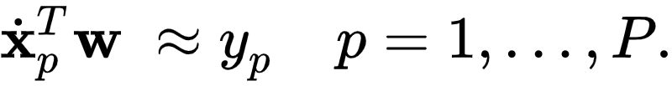
We may then write our desired linear relationships in equation (4) more compactly as

Slide 13
The Least Squares cost function

Slide 14

To find the parameters of the hyperplane which best fits a regression dataset, it is common practice to first form the Least Squares cost function.
For a given set of parameters this cost function computes the total squared error between the associated hyperplane and the data (as illustrated pictorially below).
Naturally then the best fitting hyperplane is the one whose parameters minimize this error.

Slide 15
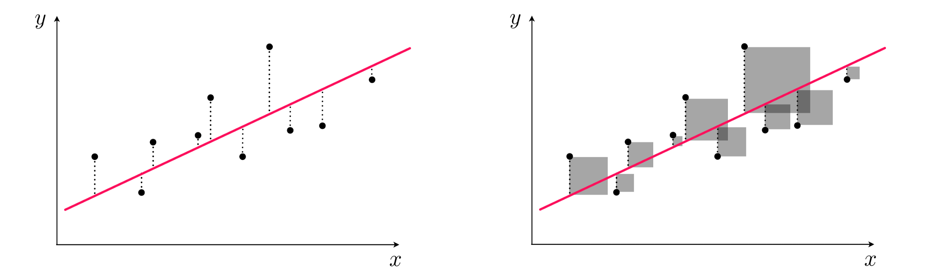

Slide 16
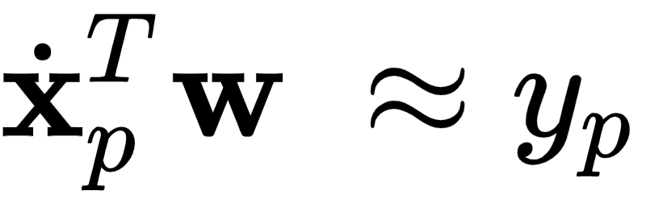
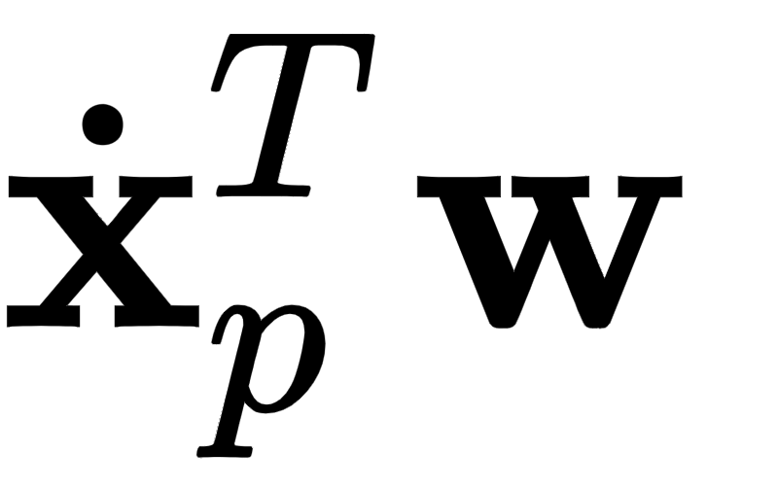
Where does this "Least Squares" cost come from?
Remember, we want to find a weight vector so that each of $P$ approximate equalities below holds as tightly as possible
Another way of stating the above is to say that the *error* between and is small.

Slide 17
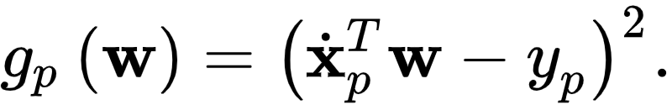
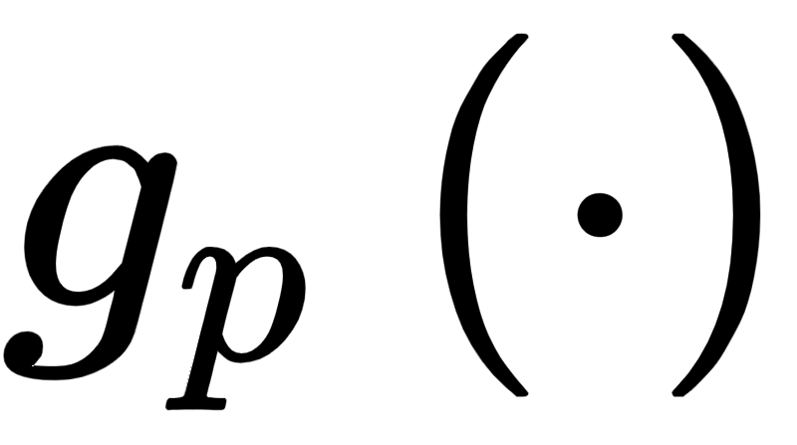
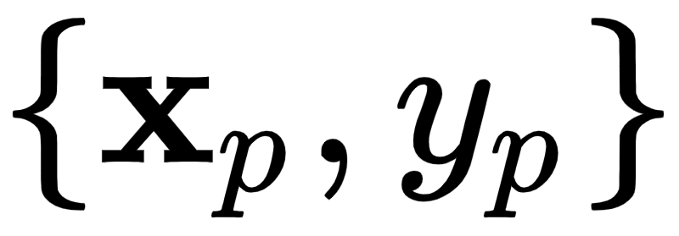
One natural way to measure error between two quantities like this measure its square (so that both negative and positive errors are treating equally) as
This squared error is one example of a point-wise cost that measures the error of a model (here a linear one) on the point

Slide 18
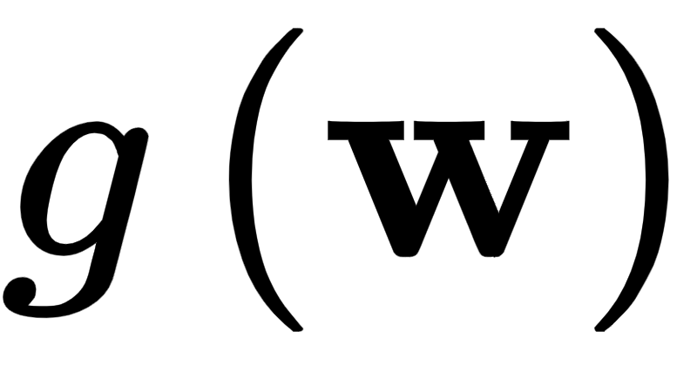
Since we want all P such values to be small we can take their average - forming a Least Squares cost function for linear regression
Note that the Least Squares cost function is not just a function of the weights , but of the data as well.
However when we express the function in mathematical shorthand as (as we do on the lefthand side above) we only show dependency on the weights .

Slide 19
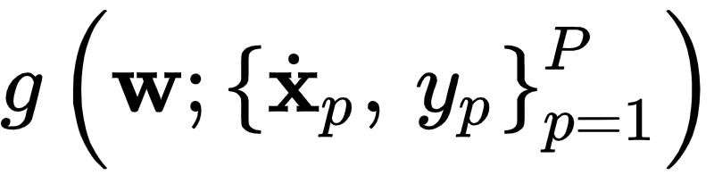
Why do we do this? Largely for notational simplicity: if we show dependency in our functional shorthand and write things start to get too messy.
Moreover, for a given dataset the weights are the important input - since this is what we need to tune in order to produce a good fit.

Slide 20
Because of this we will often refer to the Least Squares cost using the notation , but the reader can keep in mind this subtle point that it is indeed a function of the data as well.
We will make this sort of notational simplification for virtually all future machine learning cost functions we study as well.

Slide 21
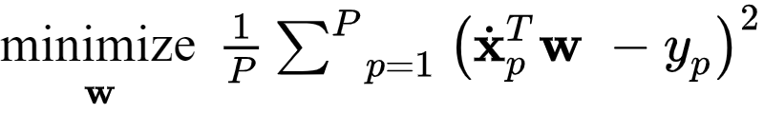
Indeed we want to tune our parmeters to minimize the Least Squares cost...
...since the larger this value becomes the larger the squared error between the corresponding linear model and the data, and hence the poorer we represent the given dataset using a linear model.
In other words, we want to determine a value for weights that minimizes , or written formally

Slide 22
Implementing the Least Squares cost in `Python`

Slide 23
When implementing a cost function like Least squares it is helpful to think modularly, with the aim lightening the amount of mental 'bookkeeping' required, breaking down the cost into a few distinct pieces.
Here we can really break things down into two chunks: we have our model - a linear combination of input - and the cost (squared error) itself.

Slide 24
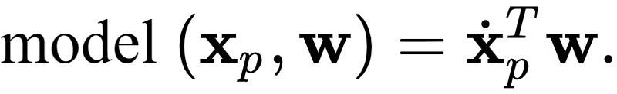
We can express our linear model - a function of our input and weights - is a function worthy enough of its own notation.
We will write it as

Slide 25
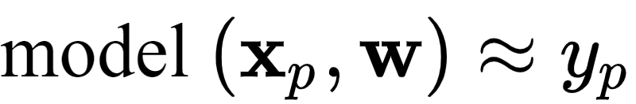
If we were to go back then and use this modeling notation we could equally well e.g., our ideal settings of the weights our original approximation as
and likewise our Least Squares cost function itself as

Slide 26
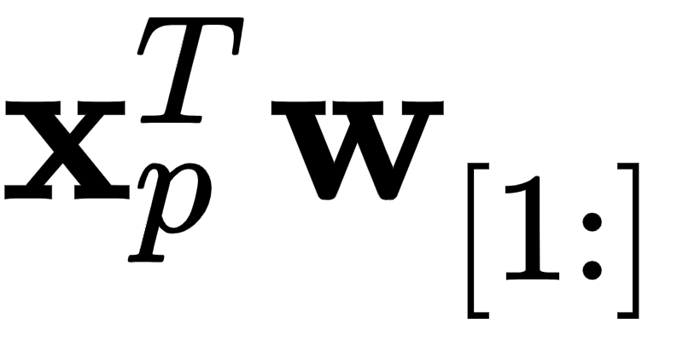
To write this in `Python` we un-ravel the bias from our weights, using slicing and express the model computation as follows
a = w[0] + np.dot(x_p.T,w[1:])
The linear combination - implemented using `np.dot` - is very efficient (far more than an explicit for loop in `Python`).

Slide 27
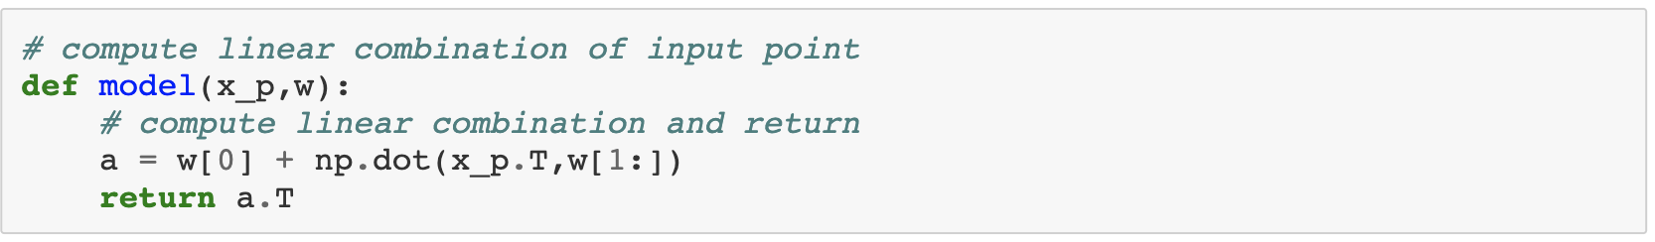

Slide 28
Next, in writing out the Least Squares function we could explicitly loop over our P points one at-a-time.

Slide 29
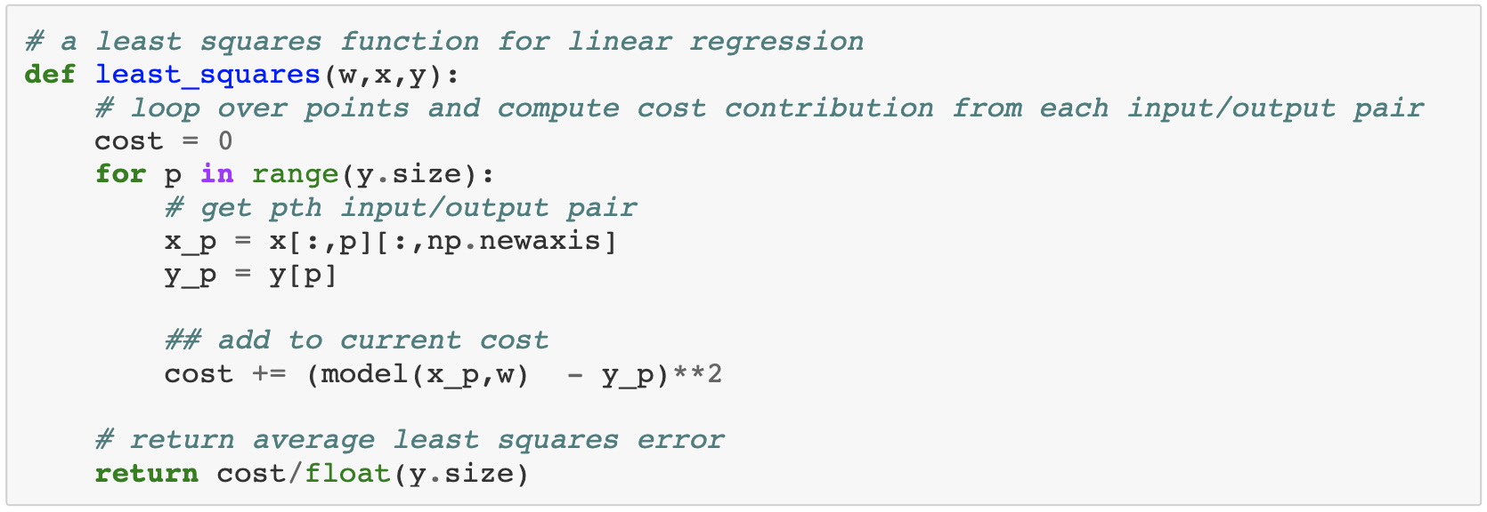

Slide 30
However when such for loops can be equivalently written using `numpy` operations, this is typically far more efficient.
Explicit `for` loops (including list comprehensions) written in `Python` are rather slow due to the very nature of the language (e.g., it being a dynamically typed interpreted language)

Slide 31
It is easy to get around most of this inefficiency by replacing explicit `for` loops with numerically equivalent operations performed using operations from the `numpy` library.
``numpy`` is an API for some very efficient vector/matrix manipulation libraries written in ``C``. In fact ``Python`` code, employing heavy use of ``numpy`` functions, can often execute almost as fast a raw ``C`` implementation itself.

Slide 32
Below we show compact implementations of both our model and Least Squares cost in `Python` leveraging `numpy`.

Slide 33
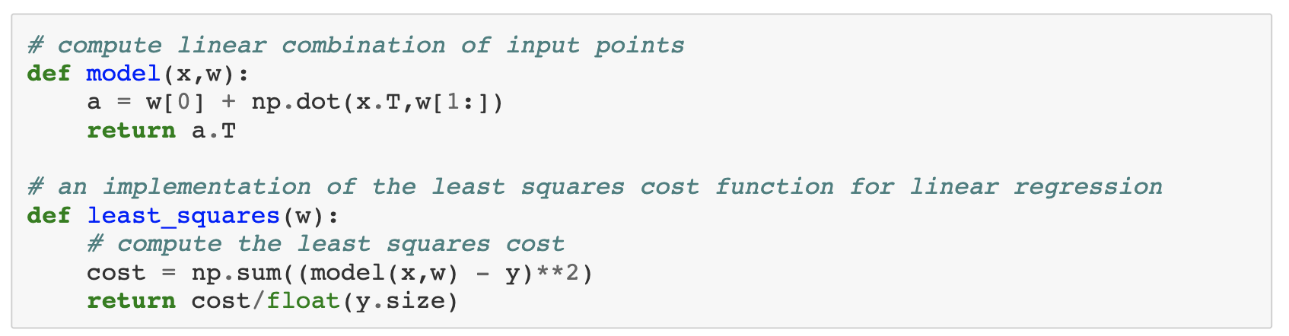

Slide 34
Notice too that for simplicity we write the the `Pythonic` Least Squares cost function `least_squares(w)` instead of `least_squares(w,x,y)`, where in the latter case we explicitly list its other two arguments: the input `x` and output `y` data.
This is done for notational simplicity, as `autograd` will correctly differentiate both forms (since by default it computes the gradient of a `Python` function with respect to its first input only).
We will use this kind of simplified `Pythonic` notation when introducing future machine learning cost functions as well.

Slide 35
Minimization of the Least Squares cost function

Slide 36
Now, determining the overall shape of a function - i.e., whether or not a function is convex - helps determine the appropriate optimization method(s) we can apply to efficiently determine the ideal parameters.
In the case of the Least Squares cost function for linear regression it is easy to check that *the cost function is always convex regardless of the dataset*.
Indeed further, it is always a convex quadratic function for any dataset used.

Slide 37
For small input dimensions (e.g., N=1) we can empirically verify this claim for any given dataset by simply plotting the function g - as a surface and/or contour plot - as we do in the example below.

Slide 38
Example: Visually verifying the convexity of the cost function for a toy dataset

Slide 39
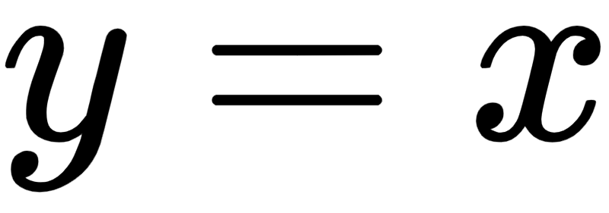
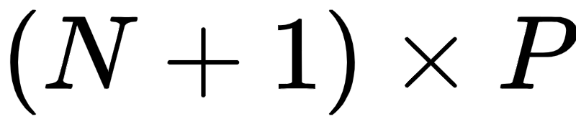
In this example we plot the contour and surface plot for the Least Squares cost function for linear regression for a toy dataset.
This toy dataset consists of 50 points randomly selected off of the line , with a small amount of Gaussian noise added to each.
Notice that the data is packaged in a array, with the input being in the top N rows and the corresponding output is the last row.

Slide 40
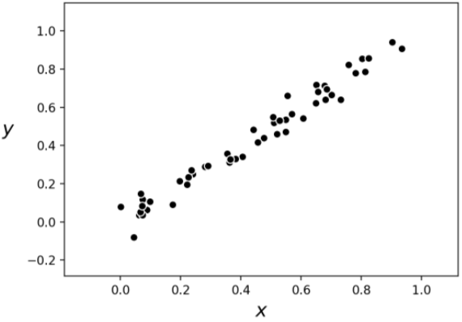

Slide 41
The contour plot and corresponding surface generated by the Least Squares cost function using this data are shown below.

Slide 42
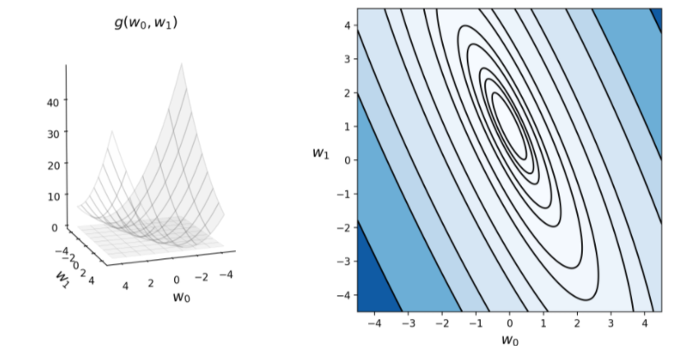

Slide 43
Example: Using gradient descent to minimize the Least Squares cost on our toy dataset

Slide 44
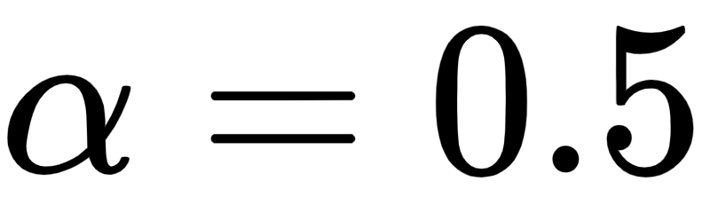
Below we minimize the Least Squares cost using the toy dataset presented in Example 2.
More specifically we use gradient descent and employ a fixed steplength value for all 75 steps until approximately reaching the minimum of the function.

Slide 45
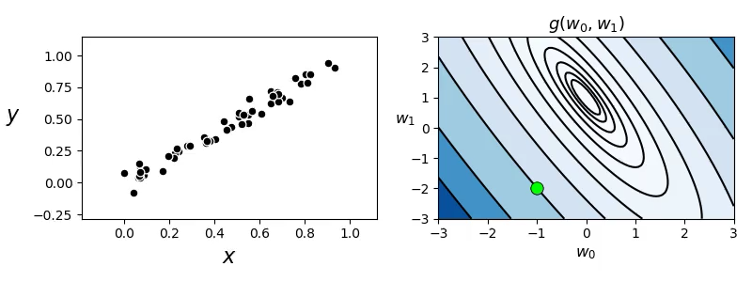

Slide 46
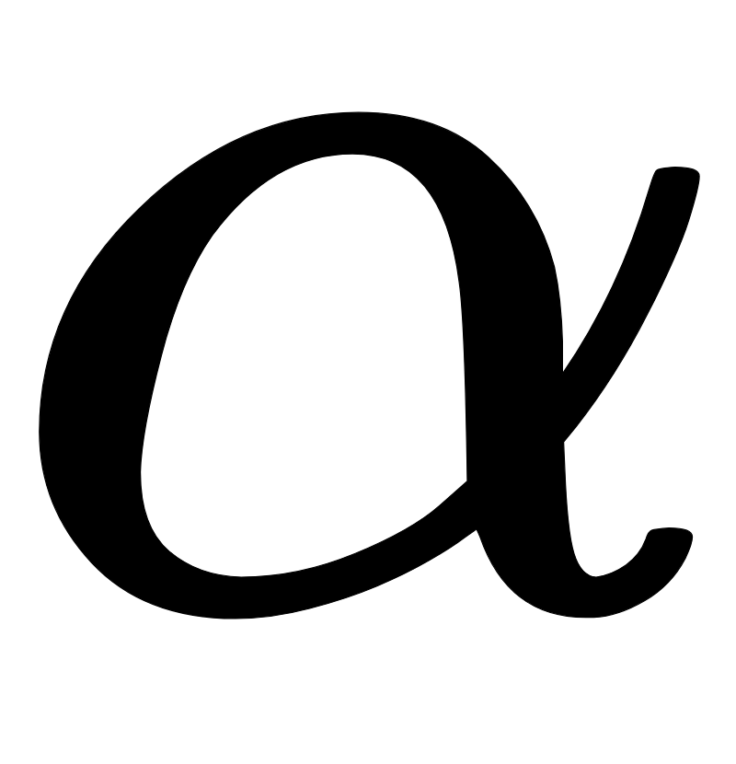
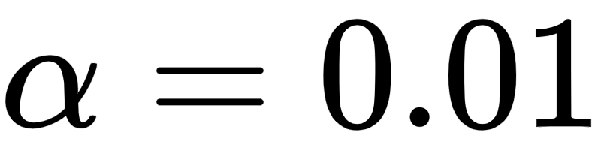
Whenever we use a local optimization method like gradient descent we must properly tune the steplength parameter .
We did this for the run above by trying several fixed steplength values.
Below we re-create those runs using , , showing the the cost function history plot for each steplength value choice. We can see from the plot that indeed the first steplength value works considerably better.

Slide 47
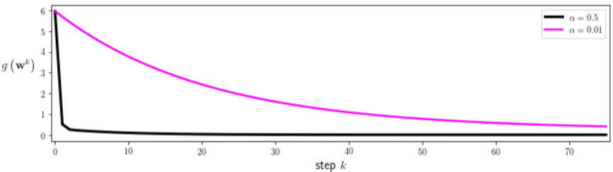

Slide 48
Example: Completely minimizing the Least Squares cost function using a single Newton step

Slide 49
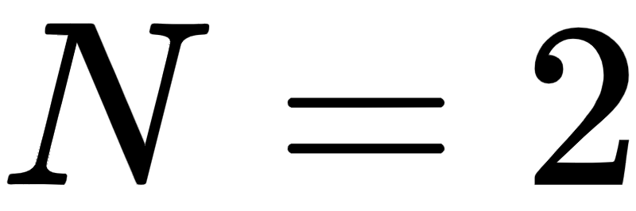
In [Section 4.4] we described how Newton's method perfectly minimizes any convex quadratic function in a single step.
One can easily show (see text) that the Least Squares cost function is a convex quadratic function for any dataset.
Thus, a single Newton step will completely minimize it regardless of the dataset used
We show this below for the toy dataset with inputs.

Slide 50
